Slide 1
CSE Cloud
Tuesday 5th June, 2018

Slide 2
Supervised By:
Dr. MD. Motiur Rahman
Professor
Department of CSE
MBSTU
Prepared By:
Mirza Inkiad Ahmed Prangon
ID: CE13015
Department of CSE, MBSTU
Tammum Islam
ID: CE13030
Department of CSE, MBSTU

Slide 3
We Welcome All of You
Lets explore our idea in cloud computing.

Slide 4
Introduction
This project is about improving the CSE lab using Cloud Environment.
Thus in this project a test cloud system based on Openstack open source project has been implemented. Openstack is a Infrastructure as a Service cloud environment.

Slide 5
Terminologies
Image – Self contained file of operating system.
Instance – A virtual machine run from a particular image.
Dashboard – Graphical User Interface (GUI) of Openstack.
SSH – Secure Shell, a protocol to access and run commands in remote host.

Slide 6
Existing Lab Environment
Multiple similarly configured and software installed machines.
Different computational ability of the machines.
Hard to maintain, consumes too much labor and time.
Hard to troubleshoot problem.
Redundant software installation.
No way to retain data and work done by a single student.
Start of each semester and before lab final requires purging of each system. This takes much time and is inefficient.

Slide 7
Our Proposed Solution: Move to Cloud
We propose to move our whole lab environment to a Cloud System. We have test built a cloud system which will cater to our need. This is our project: CSE Cloud.

Slide 8
Benefits of Our Proposed Cloud System
Easy to deploy multiple machines with same configuration.
Power over the computational ability of each machines.
Easy to maintain hardware and software.
Problems can be resolved easily.
Software installation redundancy can be removed.
Individual instance can be allocated to each individual student enabling option to retain students data.
Purging of machines is very easy and takes little time.

Slide 9
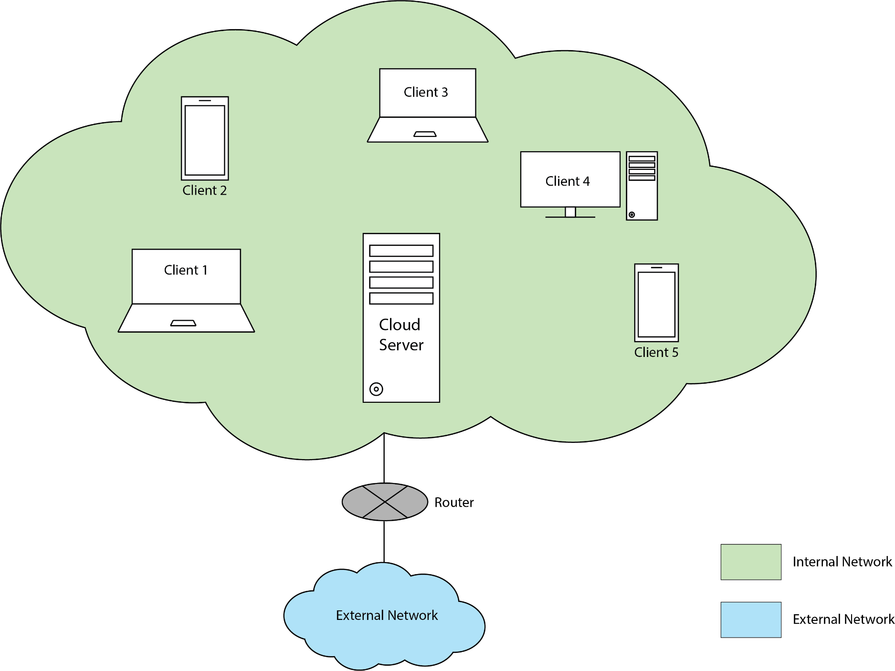
Diagram of Proposed LAB Environment

Slide 10
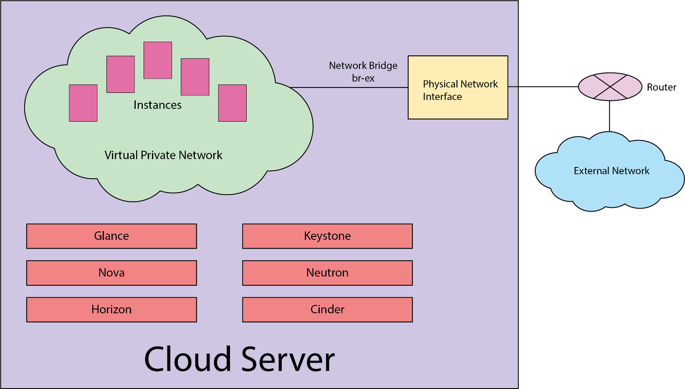
Server Architecture

Slide 11
Test Environment
Test machine specification-
CPU: Intel i5 3540 4 cores/4 thread
RAM: 16GB DDR3
HDD: 500GB
NIC: Gigabit Ethernet
OS: CentOS 7
Openstack – RDO Packtack project.
Client machines:Total 5 machines - 2 laptops, 2 mobiles, 1 desktop
Machines were of different specification.
Networking equipment: Wireless Router, Ethernet cables.

Slide 12
Test Procedure
Openstack was installed using RDO packstack.
Cloud image was sourced from online mirror as well as created manually.
Individual client machines were used to access the server.
Instances were launched using every image added to the system.
Each instances was accessed from client machines.
Internet access and internal network among instances were tested.

Slide 13
Outcome
Server machine could be accessed from every client machine under same network.
Each instances consisting of different operating systems were accessible from client machines.
Computational activities could be performed on instances.
Resources could be allocated to individual users as well as shared among group of users.

Slide 14
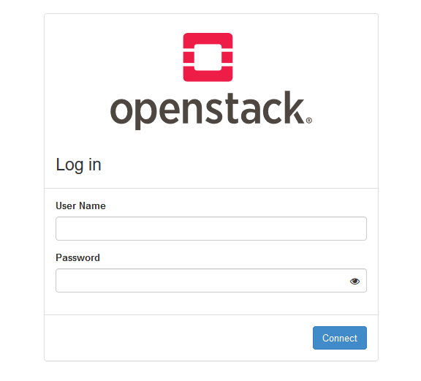
Main Login Screen

Slide 15
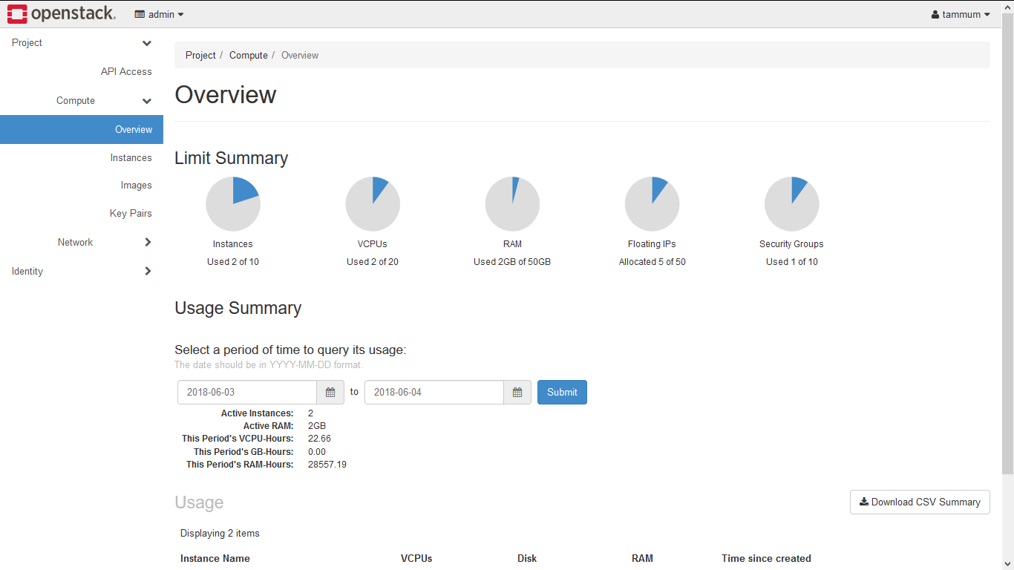
Main Dashboard

Slide 16
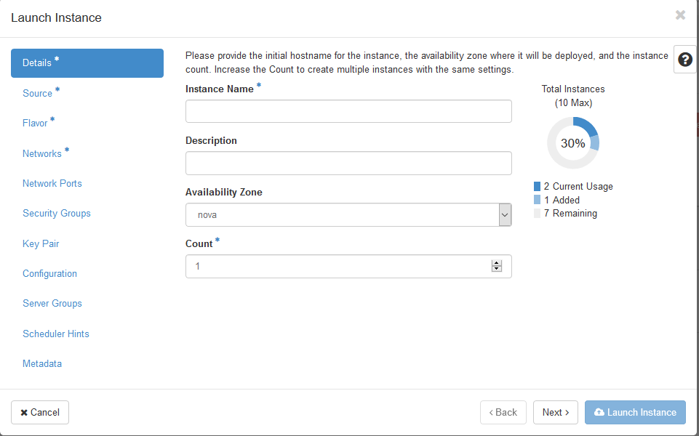
Launching Instance

Slide 17
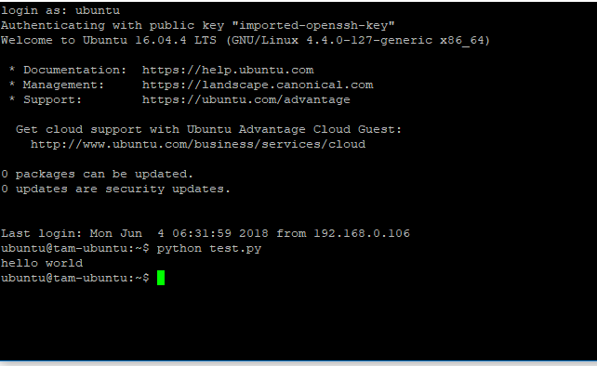
Accessing Instance through SSH

Slide 18
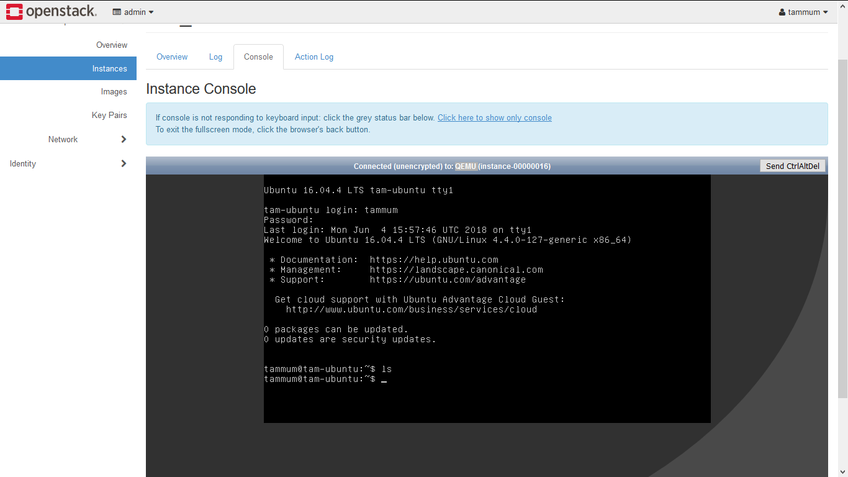
Accessing Instance through Horizon

Slide 19
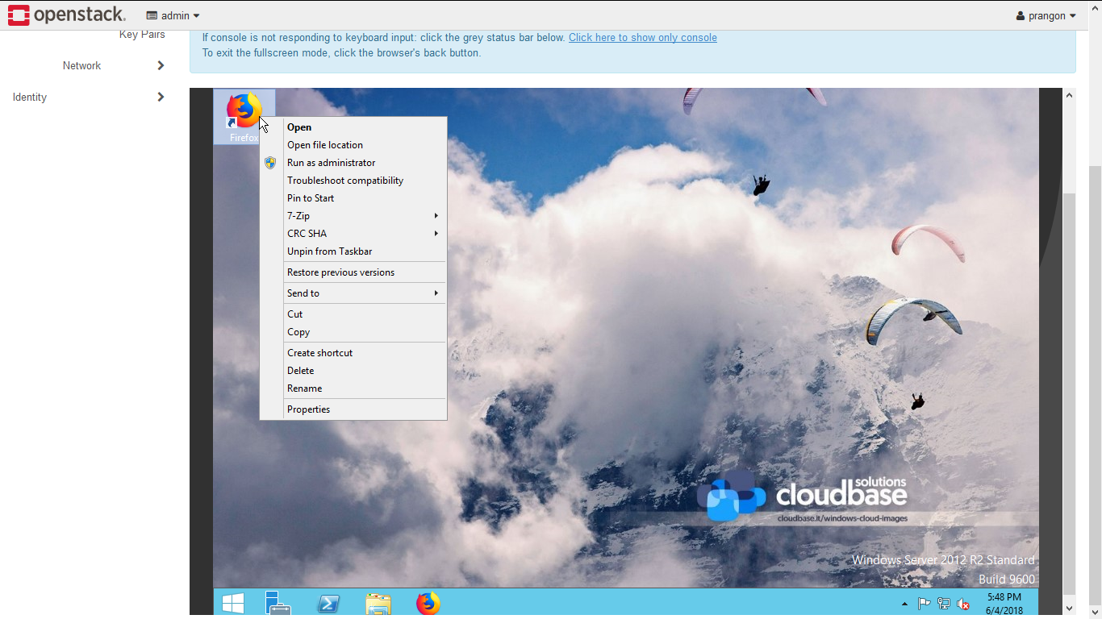
Accessing GUI Instances

Slide 20
Comments
Resources can be shared.
Operating systems and software can be used from any machine regardless of client machines specification.
Each student can be allocated a virtual machine which will act as dedicated computer enabling the student to save data and access them from any device.
Specific software can be installed depending on user need to each instance individually.

Slide 21
Future Plan
Full installation of proposed system in the CSE lab environment on multiple nodes.
Allocate each student a virtual computer from the cloud system.
Making the cloud system enable a SaaS service.
Doing some research to make the existing system more efficient.

Slide 22
Thank You All
For your patience and time.

